Slide 1
Natural Language Processing
By: Kareem Elaasar, Evelynn Vu, Nhan Thai

Slide 2
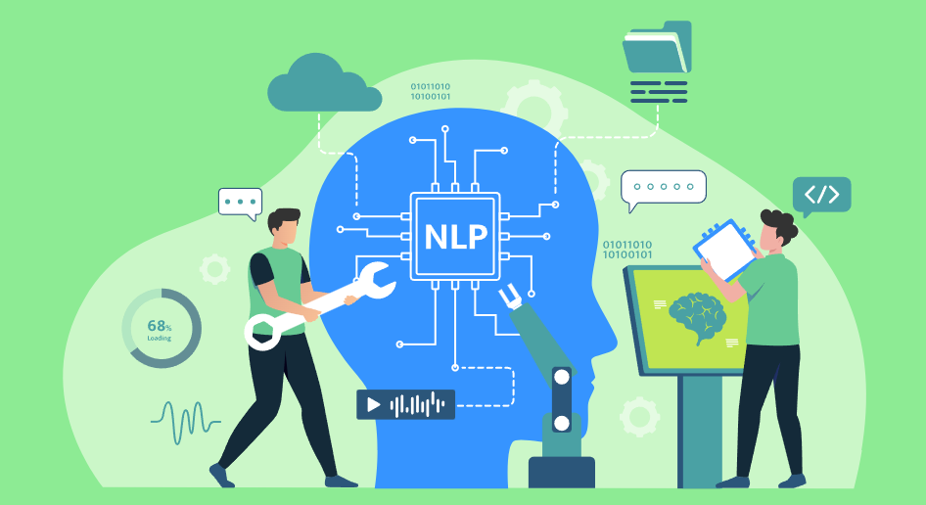
What is Natural Language Processing (NLP)
Branch of Artificial Intelligence that gives machines the ability to read, understand, and derive meaning from human languages
NLP combines the field of linguistics and computer science to decipher language structure and guidelines
Make models which can comprehend break down and separate significant details from text and speech

Slide 3
NLP Pipelines
Data Acquisition
Text Cleaning and Preprocessing
Model Building, Evaluation and Development

Slide 4
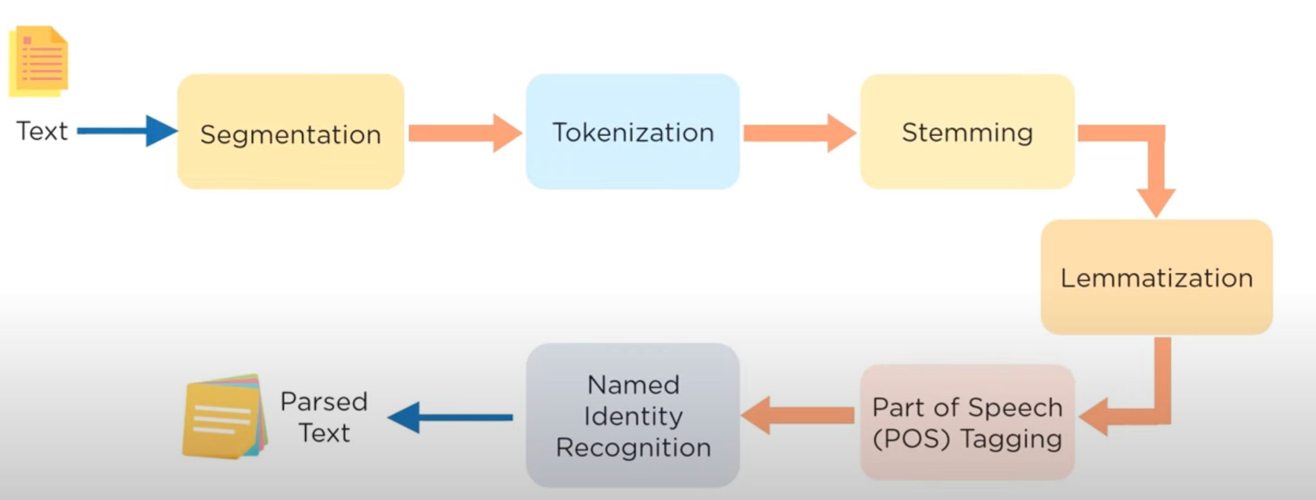
How does NLP work?
Notes:
Segmentation: segment when approach punctuations (comma, dot, question mark, etc)
Tokenization: break down the each word and store them
Stemming: gives new words upon adding affixes to them
Lemmatization:gives the new base form of a word
Part of Speech (POS) Tagging: explain the concept of nouns, verbs, articles,
Named Identity Recognition: classifying the words into subcategories
Data Aquisition,Text Preprocessing, Feature Extraction, Modeling

Slide 5
Challenges
Hallucination: Lacks evidence for claim and methods
Ambiguity: Various interpretations of words and sentences
Text formatting: Spacing and indentation
Errors in spelling: Spelling and grammar errors can create problems for analysis
Colloquialism and jargon: Slang words local to specific areas or cultures can be seen as spelling or grammar mistakes

Slide 6
Applications in Inkwave
Not used for handwritten -> digital
Filtering through text (links, numbers)
Interpretation of transcribed text using NLP process (segmentation, tokenization)
Can be used to format text by certain parameters (topic, type of word, type of sentence, etc.)

Slide 7
Model to use
Recurrent Neural Network (RNN)
Hidden Markov Model (HMM)
Convolutional Neural Network (CNN)

Slide 8
Convolutional Neural Network (CNN)
Deep learning architecture designed for processing structured grid-like data, such as images or sequences and constructed with multiple layers
Pros
Good at detecting patterns and features in images, videos, and audio signals
Can handle large amounts of data and achieve high accuracy.
Cons
Requires large amounts of labeled data
Notes:
Pros and Cons: https://www.geeksforgeeks.org/introduction-convolution-neural-network/

Slide 9
Recurrent Neural Network (RNN)
Pros:
The only neural network capable of processing binary input and having memory.
Many to many, one to many, and many to one input and productions, in contrast to other algorithms that provide one product for one input.
Cons:
Vanishing gradient problem and exploding gradient problem,
Notes:
https://k21academy.com/datascience-blog/machine-learning/recurrent-neural-networks/#:~:text=Recurrent%20Neural%20Networks%20enable%20you,the%20matter%20of%20vanishing%20gradients. -> Pros and Cons

Slide 10
Hidden Markov Model (HMM)
A Hidden Markov Model (HMM) is a statistical model which is also used in machine learning or the probability of being in a state
Pros:
Has a strong statistical foundation with efficient learning algorithms where learning can take place directly from raw sequence data
Cons
Only dependent on every state and its corresponding observed object
Notes:
HMM Pros and Cons : https://www.alibabacloud.com/blog/hmm%2C-memm%2C-and-crf%3A-a-comparative-analysis-of-statistical-modeling-methods_592049#:~:text=Advantages%20of%20HMM,handle%20inputs%20of%20variable%20length.
Definition of HMM: https://analyticsindiamag.com/a-guide-to-hidden-markov-model-and-its-applications-in-nlp/

Slide 11
Sources
https://super.ai/blog/handwriting-recognition-powered-by-artificial-intelligence
https://www.simplilearn.com/tutorials/artificial-intelligence-tutorial/what-is-natural-language-processing-nlp
https://k21academy.com/datascience-blog/machine-learning/recurrent-neural-networks/#:~:text=Recurrent%20Neural%20Networks%20enable%20you,the%20matter%20of%20vanishing%20gradients.
https://www.analyticsvidhya.com/blog/2022/05/nlp-preprocessing-steps-in-easy-way/

